Slide 1

Brew House Korea
Overview of Important CSS Styles and HTML Structure

Slide 2
What is our website?
Brew House Korea is a simple static website built by our Team for ordering coffee items.
Our Core Team Members:
Arpan Karki
Roshan Dhungel
Aayush Khadka
Joel Chaudhari

Slide 3

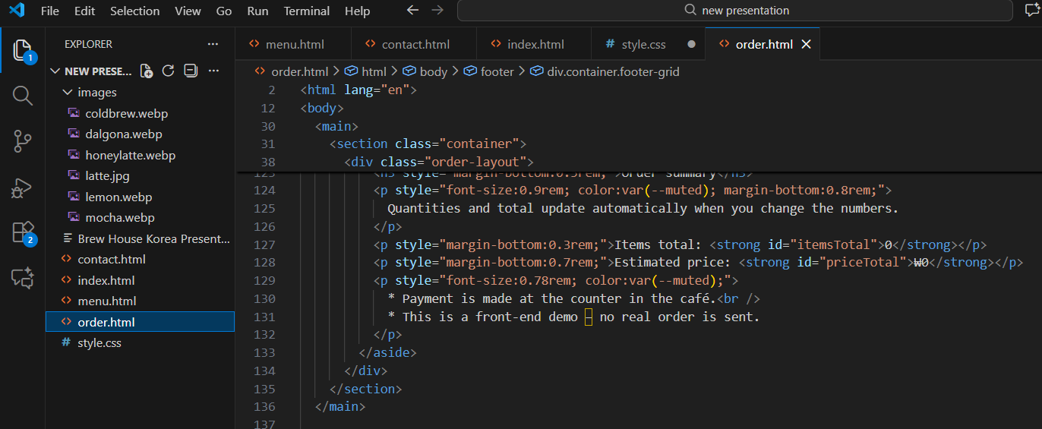
Website Structure
•
index.html: Home page with Hero section and features. (By Arpan karki)
•
menu.html: Menu cards showing drink names and prices. (By Roshan dhungel)
•
order.html: Order form - selection (By joel chaudary)
•
contact.html: Contact details and message form.
(By Aayush Khadka)
•
CSS parts were handled collectively by all the members for their respective sections and merged later.

Slide 4
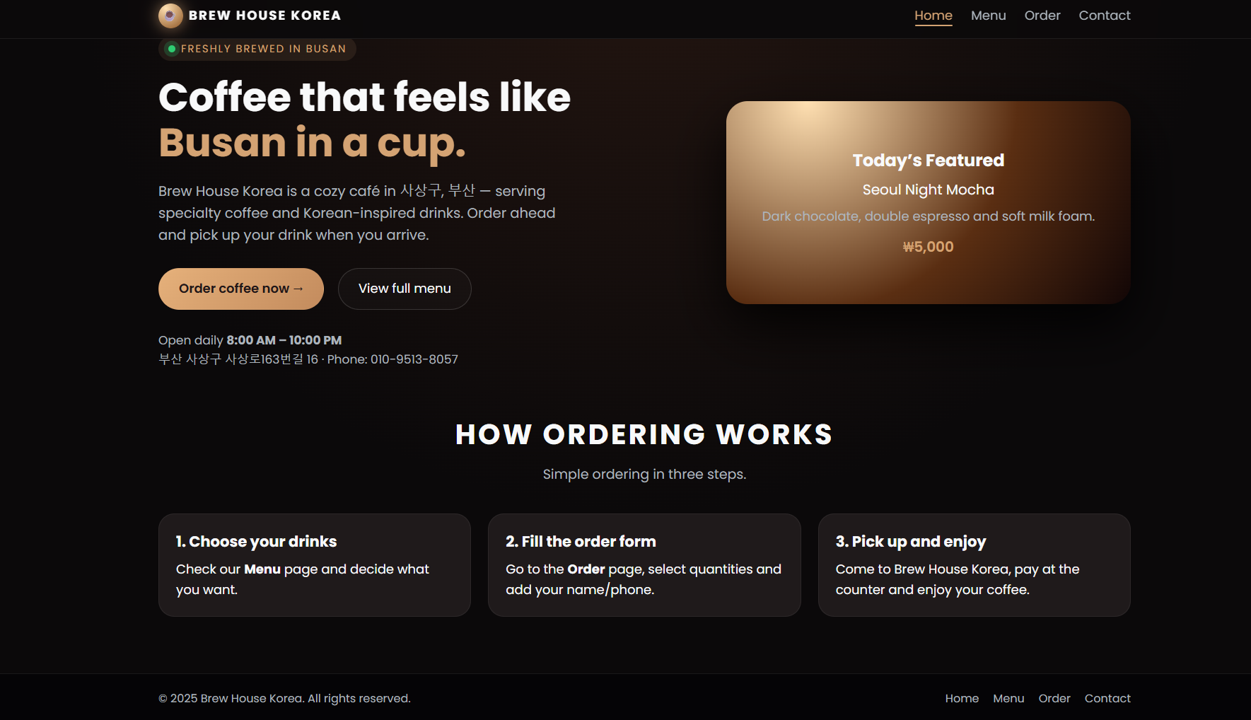
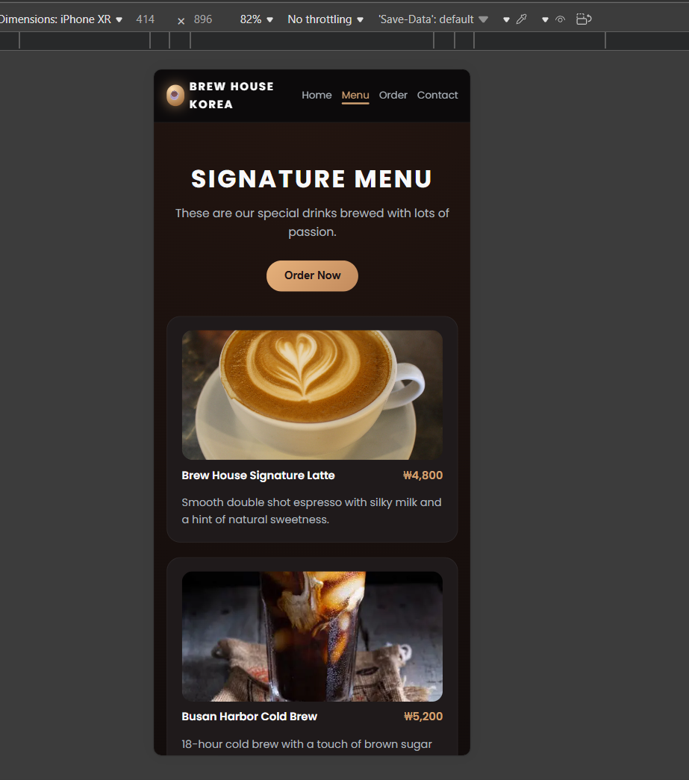
Media Responsiveness (Collective Effort)

Slide 5
Live Demo

